Slide 1
Collective Worship
Collective Worship is where the pupils come together, either as one in the hall (twice a week), or in their tutor groups (on the other days). In Collective Worship we follow weekly themes and look at how these link to our school values.
Sometimes bible stories, parables (etc..) are used and the pupils think about the meanings of these, as well as examples of similar ways these can be seen either in history or in modern life.

Slide 2
Faith and spirituality
While some children and their families will be practising Christians, others will have different beliefs. Therefore, Collective Worship is made relevant and invitational to all.
Some pupils will then follow a faith (eg. Christianity), but all can explore their spirituality. Spirituality could, for example, be felt when on a walk amongst nature, experiencing a beautiful poem, or piece of art. Such experiences can be planned for in school, or when involved in enrichment away from the school.
*Spirituality involves the recognition of a feeling or sense or belief that there is something greater than myself, something more to being human than what we can feel through our senses.

Slide 3
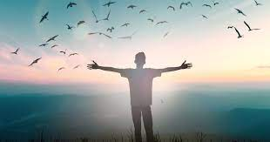
St Mary's CE Middle School,
St Mary's... a church school
Spirituality

Slide 4
St Mary's CE Middle School,
St Mary's... a church school
Visiting speakers
PSHE
The way we conduct ourselves in the school
Enrichment
A church school
Tutor group time
Collective Worship
The local church and the diocese
Lessons, curriculum time

